Slide 1
Amazon Sales analysis
-By ROSHANI SINGH(UMIP8844)

Slide 2
Problem statement
Sales management has gained importance to meet increasing competition and the
need for improved methods of distribution to reduce cost and to increase profits. Sales
management today is the most important function in a commercial and business
enterprise.
Do ETL: Extract-Transform-Load some Amazon dataset and find for me
Sales-trend -> month-wise, year-wise, yearly month-wise
Find key metrics and factors and show the meaningful relationships between
attributes. Do your own research and come up with your findings.

Slide 3
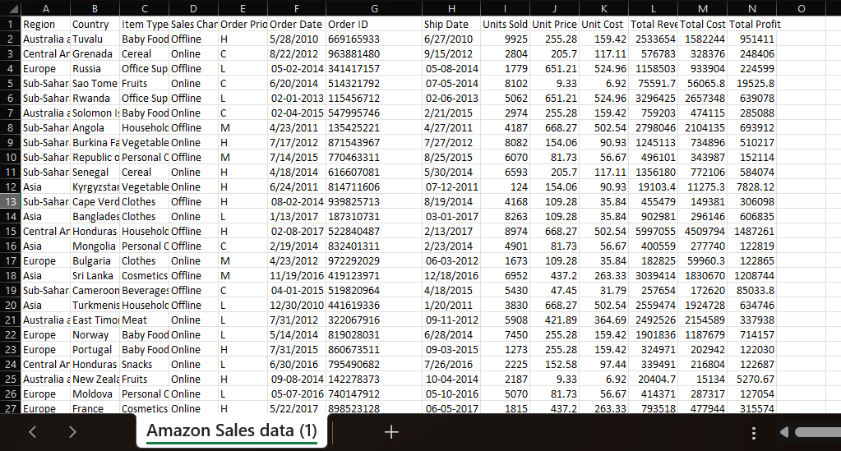
Given Dataset

Slide 4
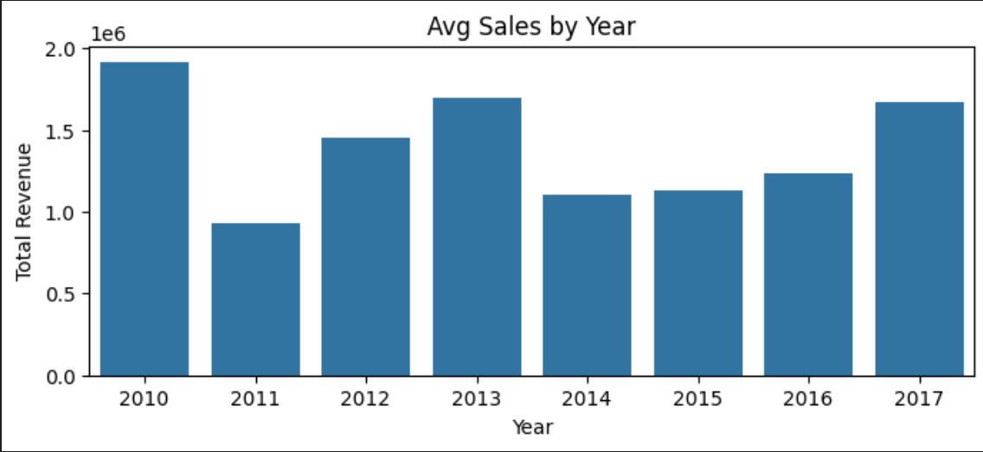
Yearly Distribution
Visualization
Explanation
Here we can see that year 2010 was best for sales.
Year 2011 was not that much beneficial.

Slide 5
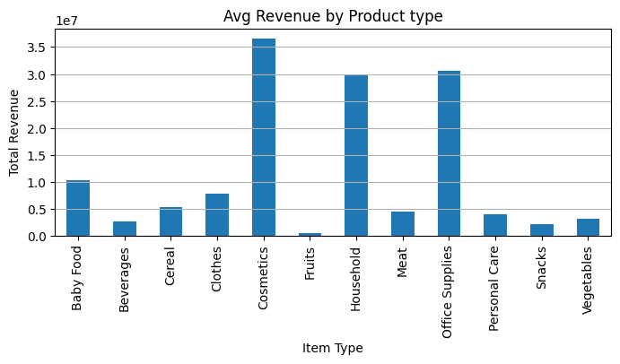
Average revenue by product type
Visualization
Explanation
This graph represents the average revenue of Amazon by product type.
Here we can see that Cosmetics and Office supplies revenues are the highest.
Fruits have the least revenue.

Slide 6
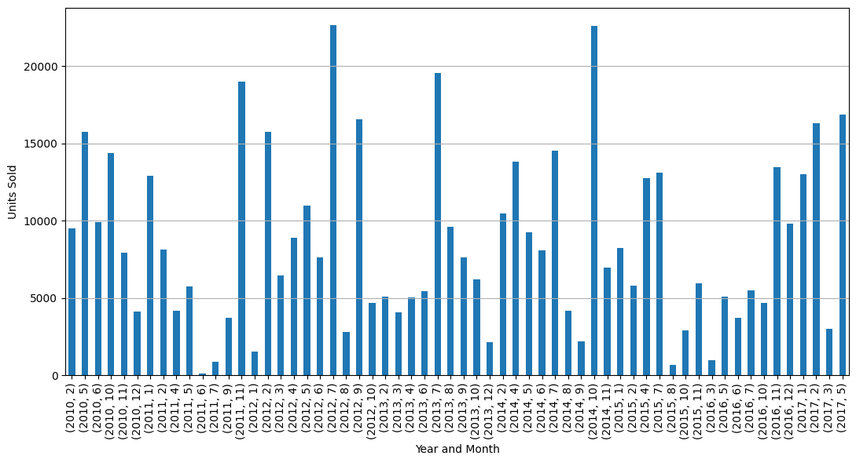
Yearly Month_wise Distribution
July 2012, has the most units sold as well as the October 2014.
June 2011, no units sold.

Slide 7
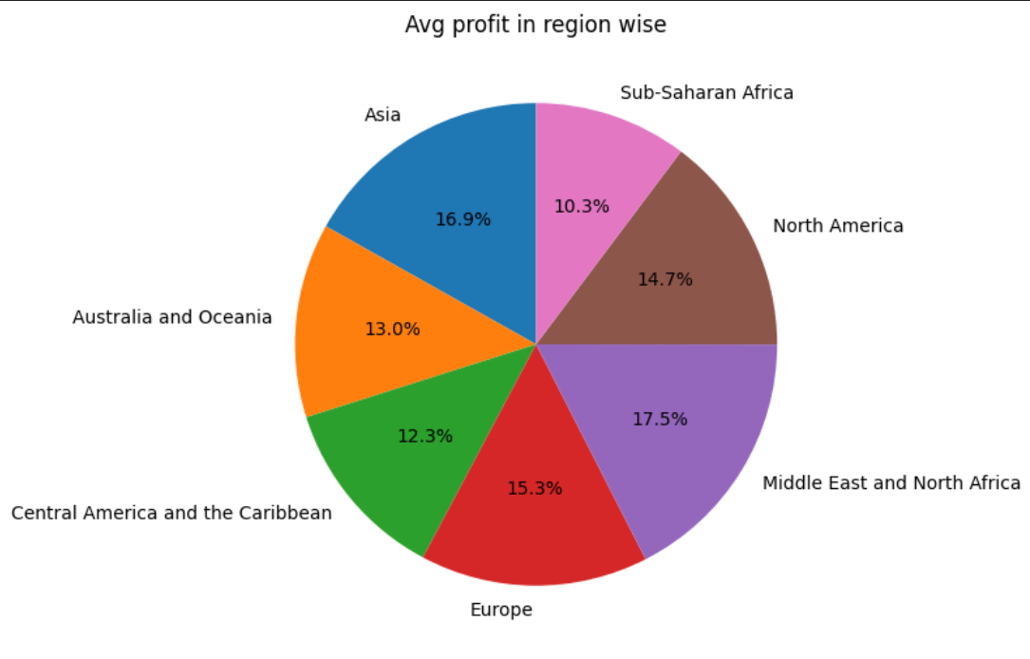
Region Wise Profit
Visualization
Explanation
Middle East and North Africa, Asia along with Europe are the countries with maximum profit.
Total Profit : 44168198.399999

Slide 8
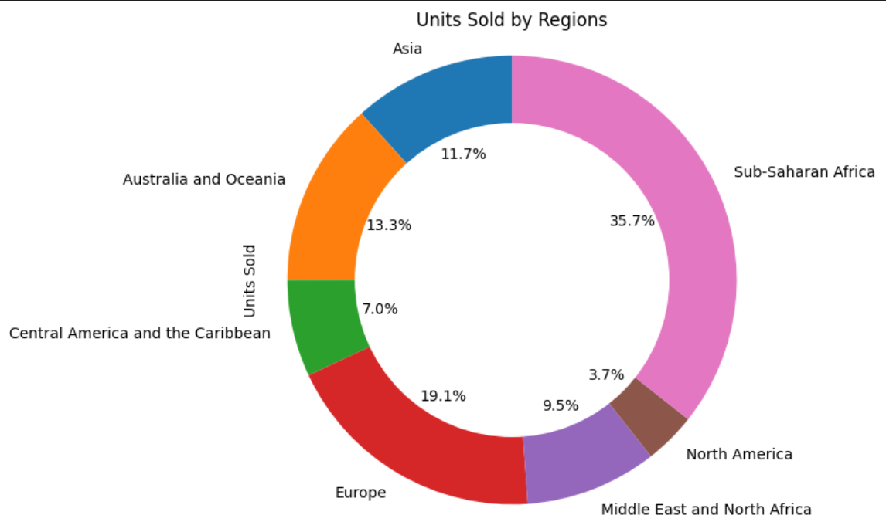
Units sold by region
Visualization
Explanation
From the graph, we can see that Sub-Saharan Africa, Europe along with Australia and Oceania are the top three countries with high Units sold in the region.
Whereas, North America is at the least position.
Total Unit Sold: 512871
Total Unit Cost: 19104.8

Slide 9
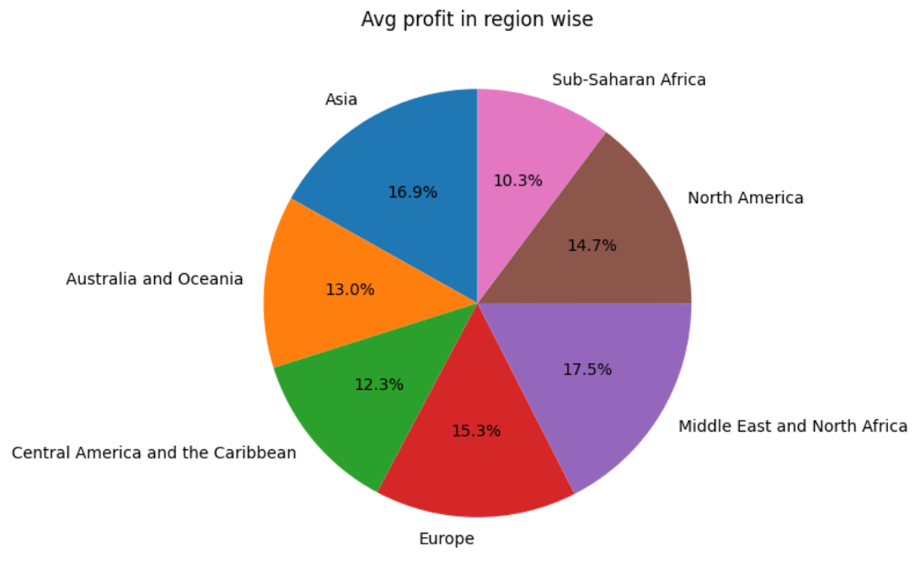
Average Profit By region

Slide 10
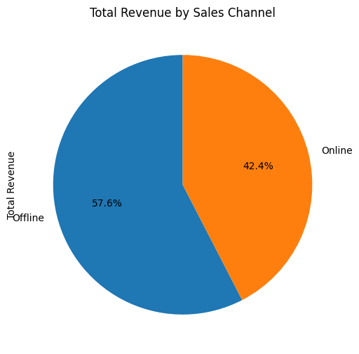
Total Revenue by sales channel (Offline or online)

Slide 11
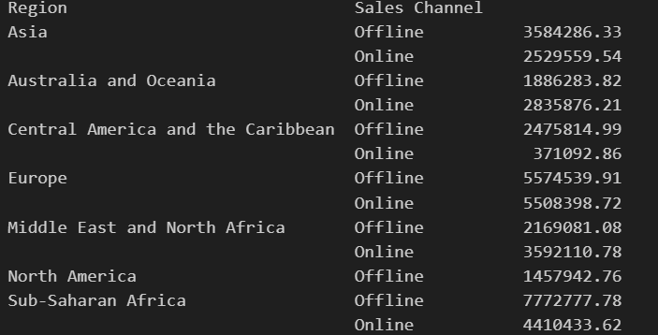
Total Profit By region
In this graph, we can see the total profit collected in every Region through Offline and Online Sales Channel.
Sub Saharan Africa collected $7772777.78 offline where $4410433.62 through online, which makes the region the best profitable region.

Slide 12
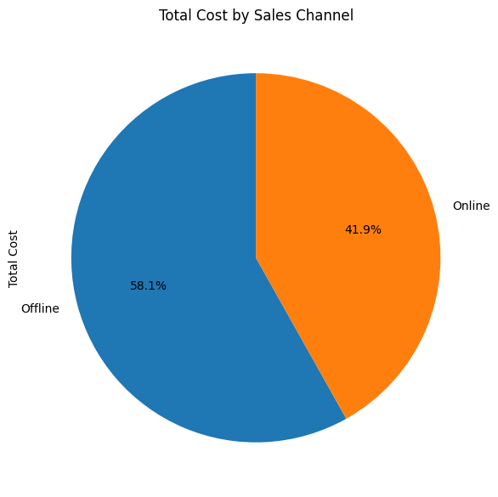
Total cost by sales channel
Visualization
Explanation
41.9% costs Online
58.1% cost Offline

Slide 13
Thank You!

